Slide 2
Platform – Design understanding session

Slide 3
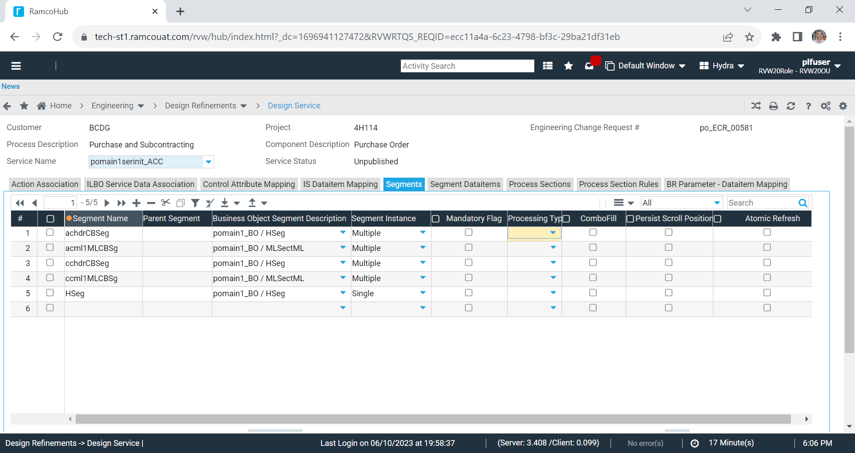
Segment Definition

Slide 4
Segment Definition
Attribute | Allowed Values | Remarks
Parent Segment |  | Not in use – Can be hidden
Business Object Segment |  | Not in use – Impact to be studied and hidden
Mandatory Flag |  | Not in use – Can be hidden ???
Segment Instance | Single, Multiple | In use - to be continued
Process Type | PSR, PMR, PSMR | For specifying process only selected, modified rows In use - to be continued
Combo Fill |  | For specifying combo filling segments In use – to be continued
Persists Scroll Position |  | For retaining scroll position after grid refresh New feature – to be continued
Atomic Refresh |  | Use case brought aviation team does meat requirement given by TECH team Not in use – Can be hidden

Slide 5
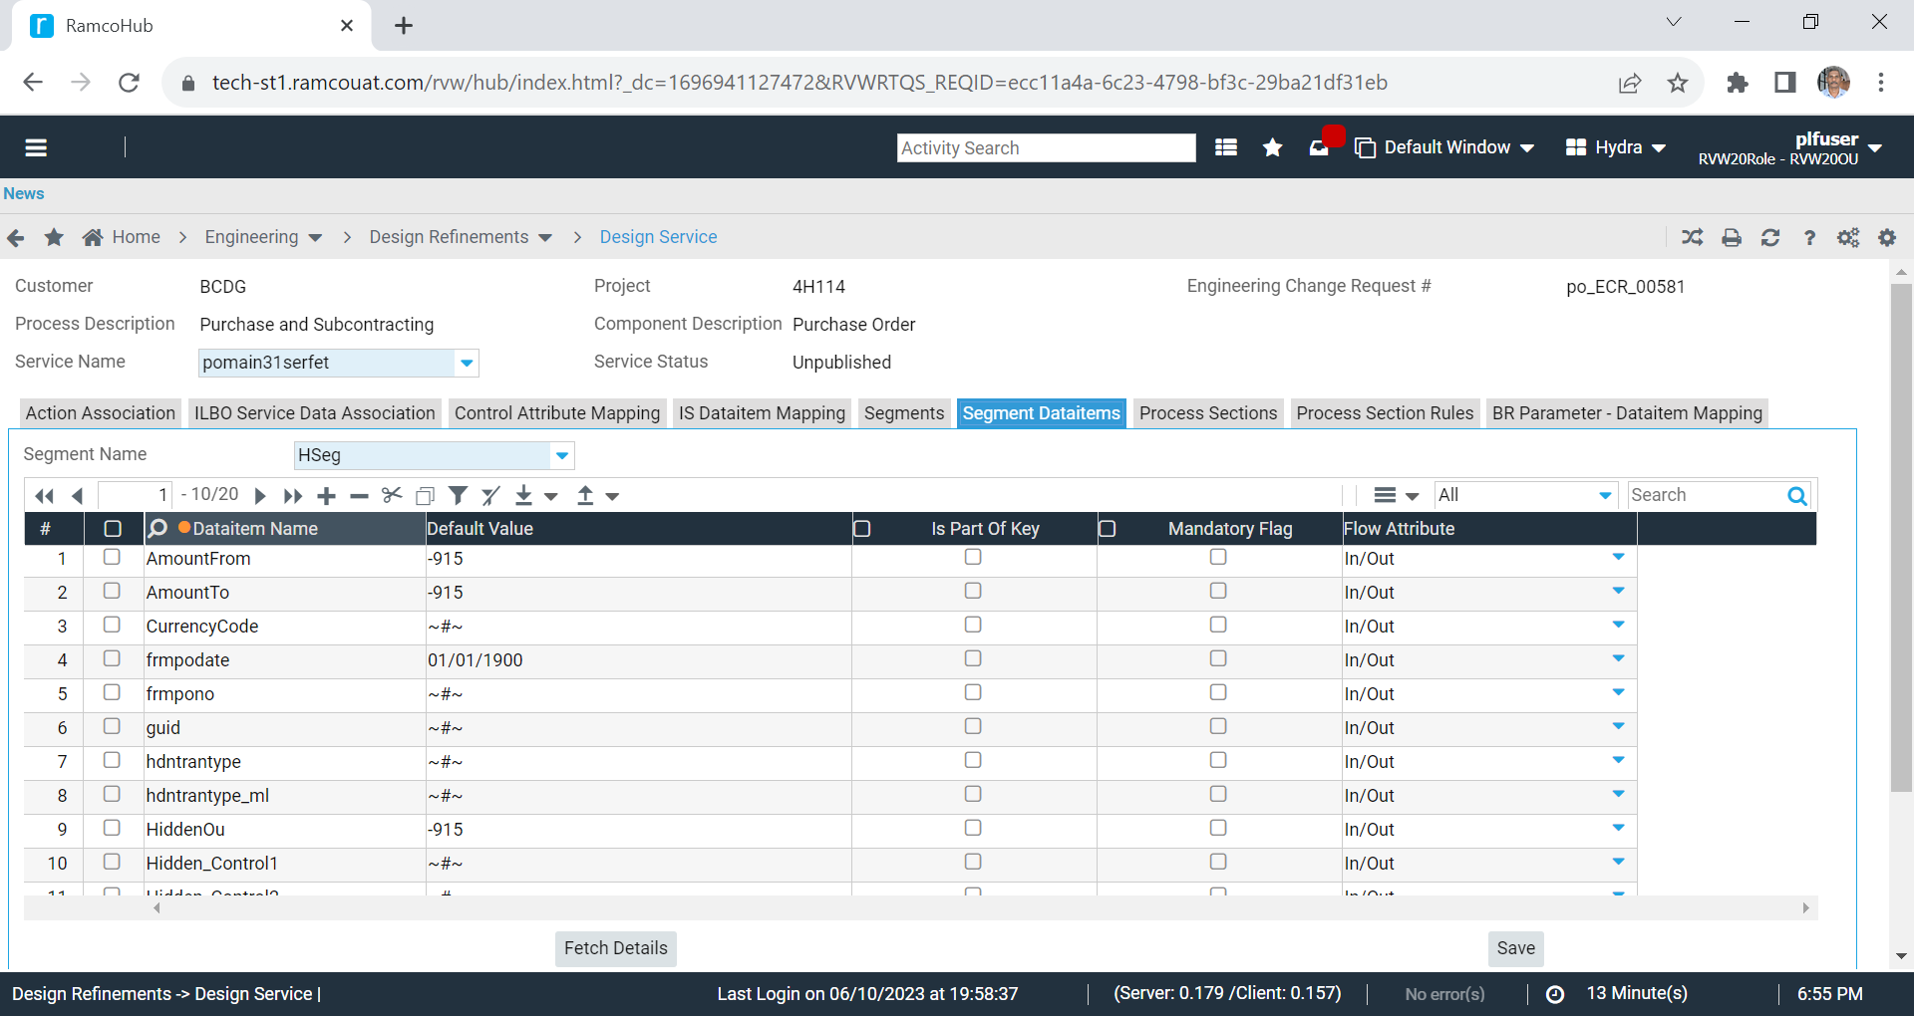
Segment Dataitem Definition

Slide 6
Segment Dataitem Definition
Attribute | Allowed Values | Remarks
Dataitem Name |  | Unique data item within a segment In use – to be continued
Default Value |  | To supply default values for segment dataitem for empty values In use – to be continued
Is Part Of Key |  | In use – to be continued To identify the key columns based on the key values records from different method output is merged
Mandatory Flag | true / false | In use – to be continued Applicable only for In and In-Out Segment dataitem Will force values to be supplied for this segment data item
Flow Attribute | IN, OUT, INOUT, SCRATCH | To specify flow direction of segment data item. In use – to be continued

Slide 7
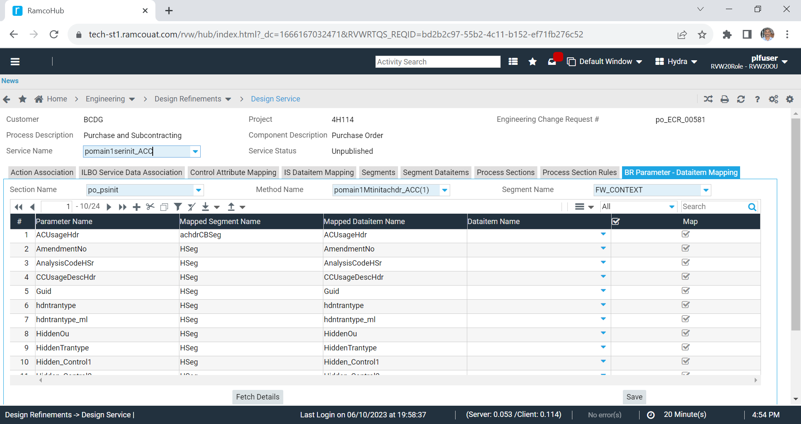
Segment Dataitem to BR Parameter Mapping

Slide 8
Segment Dataitem and BR Parameter Mapping
Relevance
Applicable only for Manual service design
Reason
For binding stored procedure parameter to segment data item mapping which inherently mapped to user interface controls.
Same method can be called one or more time(s) within a service. Hence SDI ➔ BR Param mapping is done in context of Service → Process Section → Method
Suggestion
Required – To be continued

Slide 9
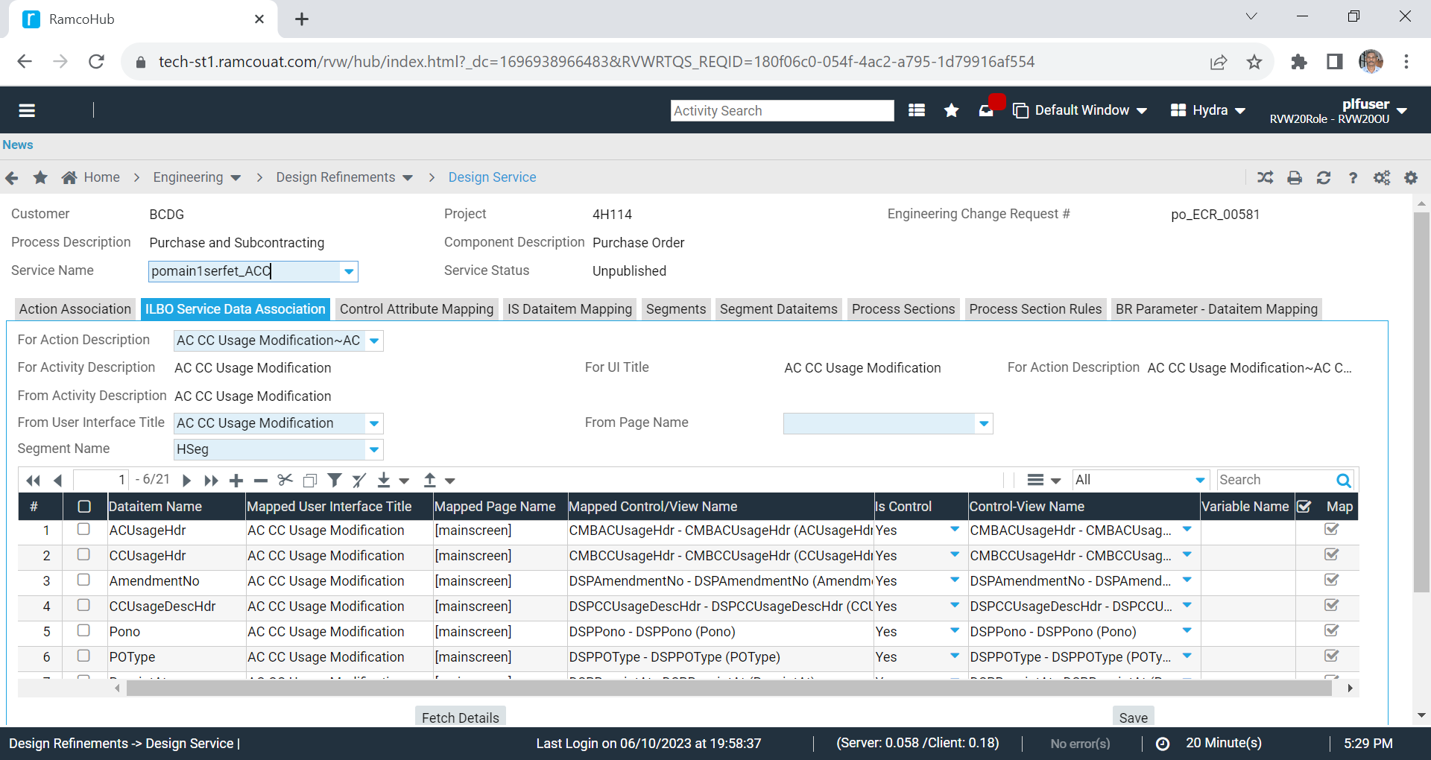
Segment Dataitem to ILBO Control Mapping

Slide 10
Segment Dataitem and ILBO Control Mapping
Relevance
Applicable only for Manual service design
Reason
For binding segment data to screen controls.
A service can mapped to one or more user interface(s) and task(s). Hence mapping is done in the context of Service → User interface → Task → Controls
Suggestion
Required – To be continued

Slide 11
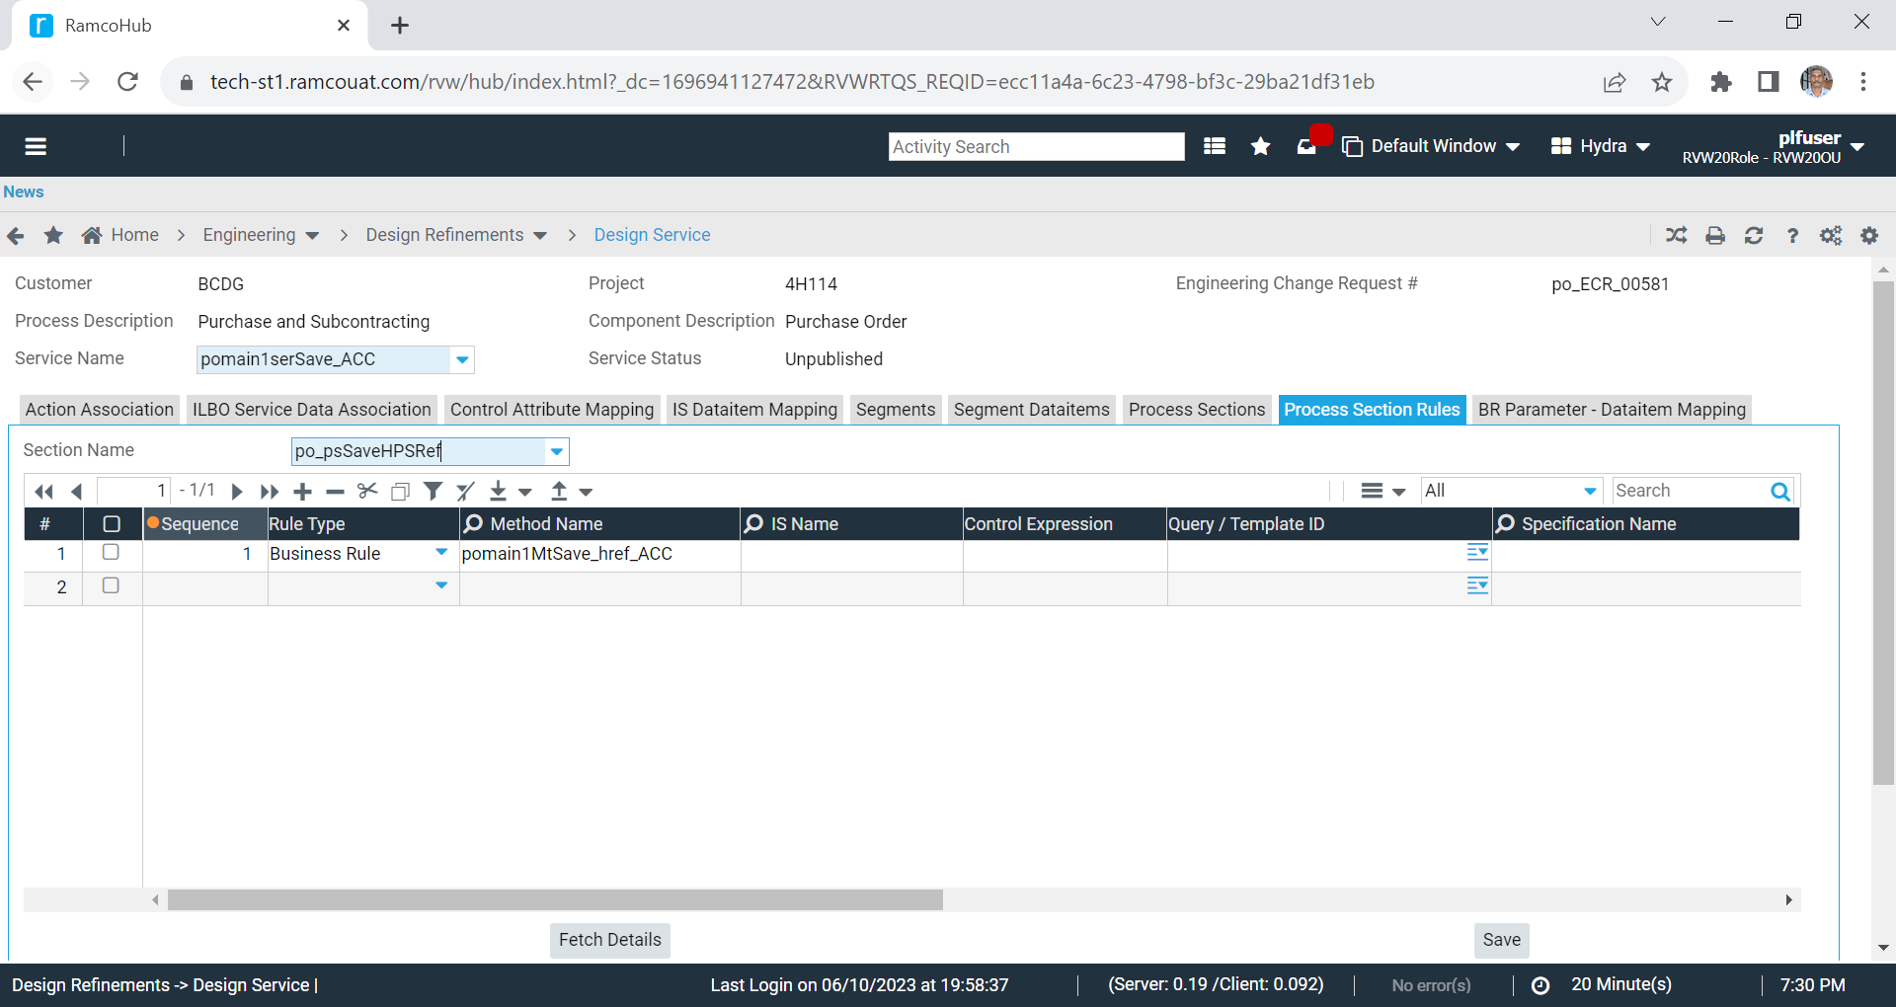
Process Section Rules

Slide 12
Process Section Rules
Attribute | Allowed Values | Remarks
Rule Type | Business Rule, Integration Service, ElasticSearch | Use to specify method implementation In use – to be continued
Query / Template |  | Used when rule type is ElasticSearch In use – to be continued
Specification Name Specification Version Path Operation |  | Not in use – can be hidden Intended for api execution at app layer
Connectivity Flag | Online / Offline | Not in use
Execution Flag | Asynchronous, Synchronous | Not in use Column title to be changed from Extension Flag to Execution Flag

Slide 13
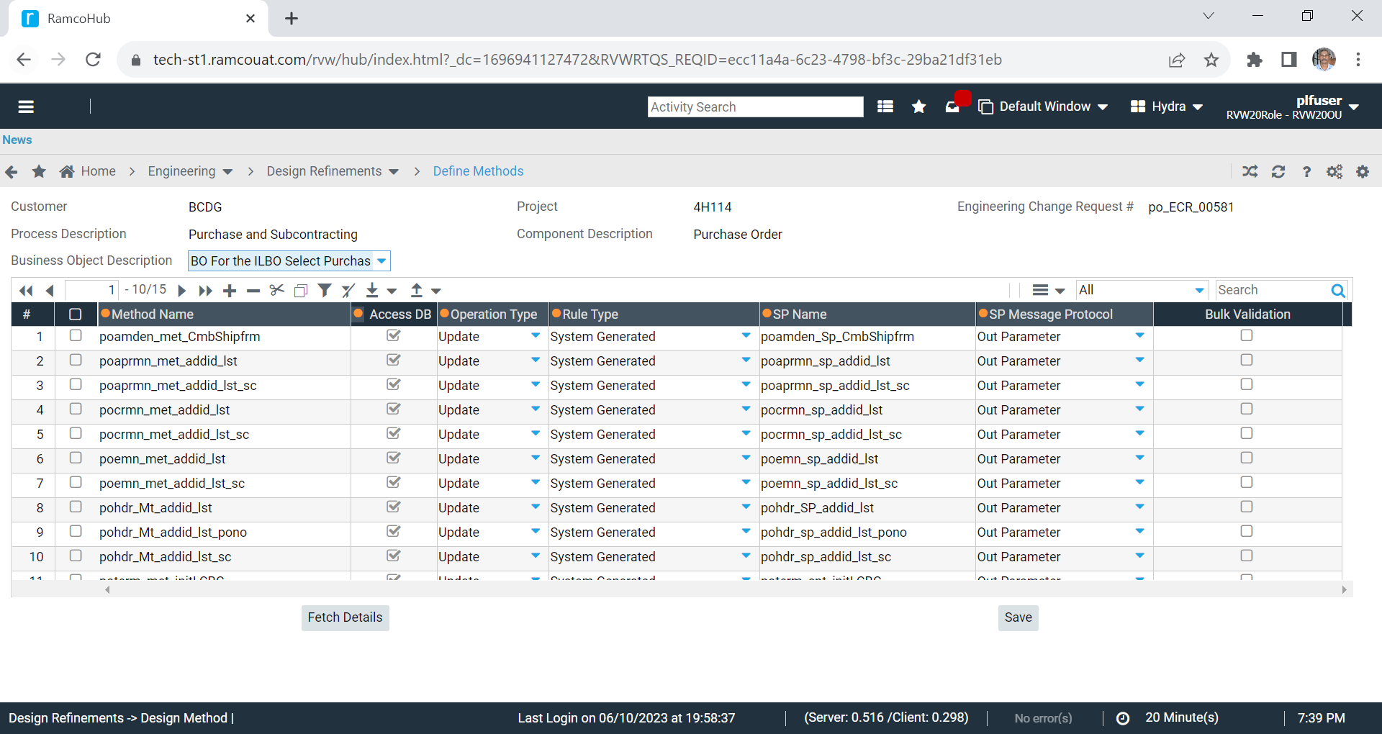
Method Definition

Slide 14
Method Definition
Attribute | Allowed Values | Remarks
Access DB | 1 or 0 | 1 – SP Execution 0 – Custom BR
Operation Type | Update / Fetch | Used to identify transaction scope. If all methods in a service is fetch, then transaction scope is not managed. In use – to be continued
Rule Type | System Generated Hand Coded Bulk Insert | Used to identify implementation property of method – Stored Procedure - BRO, - BULK Insert Method
SP Message Protocol | Output Parameter Selected Column Multiple Record Set | Output Parameter - M_ErrorID will be separate out parameter Selected Column – Used for bubble message implementation Multiple Record Set – Not in use
Bulk Validation |  | Not in use

Slide 15
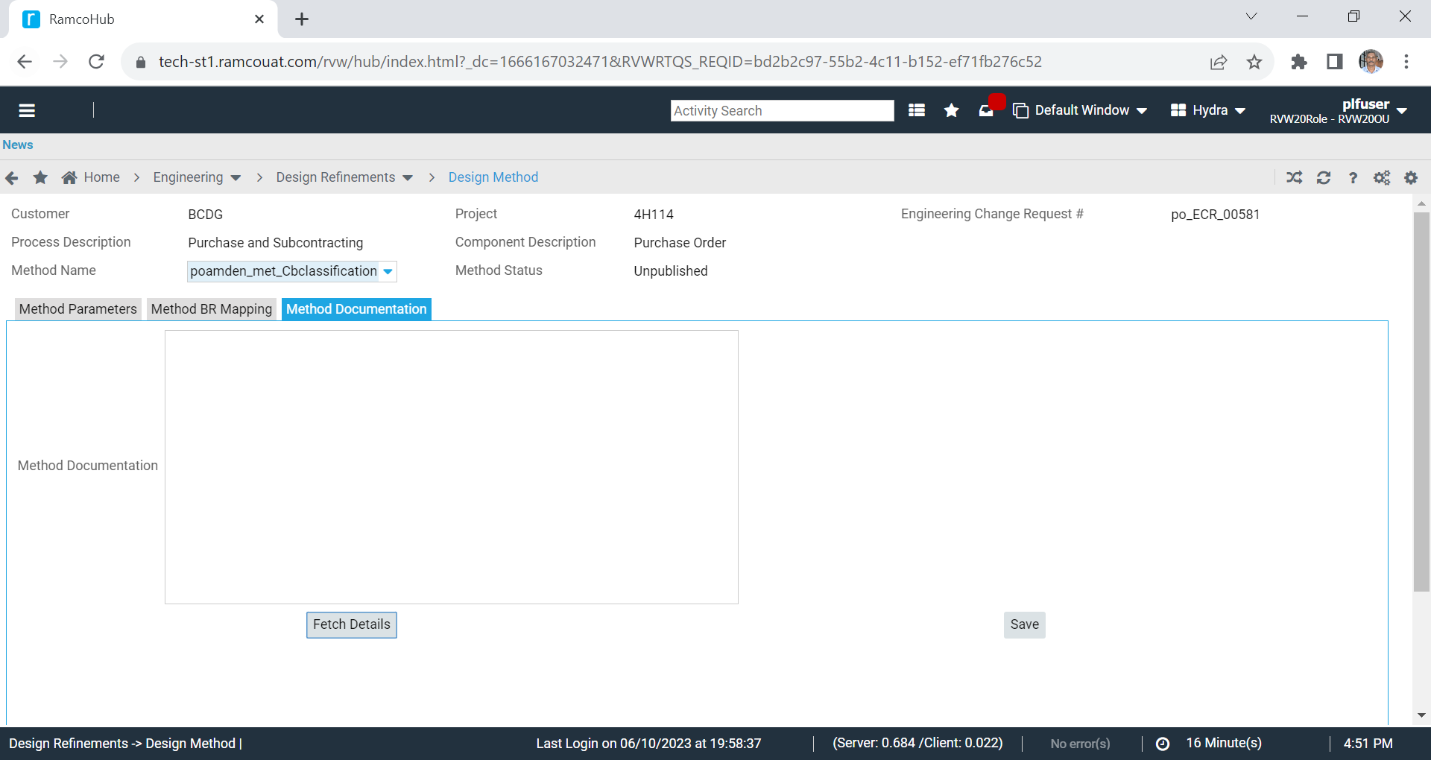
Method Documentation
Referenced Table
DE_FW_DES_BR_DOCUMENTATION
Reason
Documentation specified to be included in stored procedure stub and design document generation.
By referencing the documentation, developers can implement the business logic.
Suggestion
Not in use – Method documentation tab can be hided

Slide 16
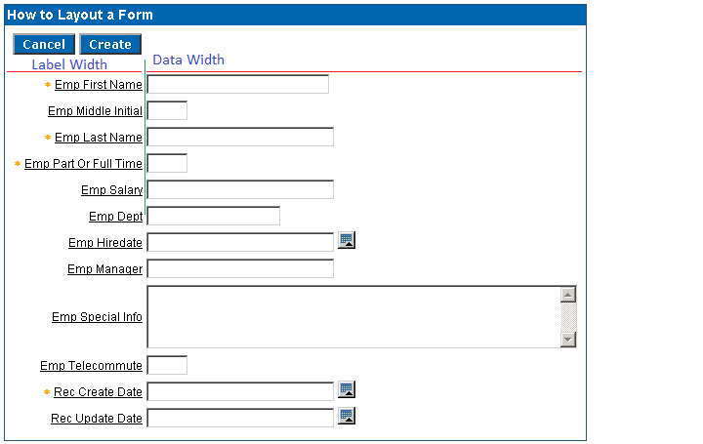
Label and Data Column Width

Slide 17
Label and Data Column Width
In workbench screen layout modeling is done in matrix format
Horizontal and vertical order will translate as individual cells
Each cell will have 100%. System will allocate 50% for label and 50% for controls. In scenarios where either of this to be modified, label and data column width can be customized
Customized label and data column width summation should be 100%.
Applicable only for header controls

Slide 18
Grid Column Width Specification
Grid Column Width Calculation Logic
Minimum Width: 30px
For Regular Grid
(Data Length * 12) + 20 (column help) + 4 (column mandatory) + column (combo / date / datetime / time (25)
For Force Fit Grid
Same as above - but remain white space was calculated based on percentage using column data length.
Combination of both is not applicable.

